Slide 1
Horseshoe Lake
Beautification Committee

Slide 2
Leocadia Park / Boat Launch

Slide 3
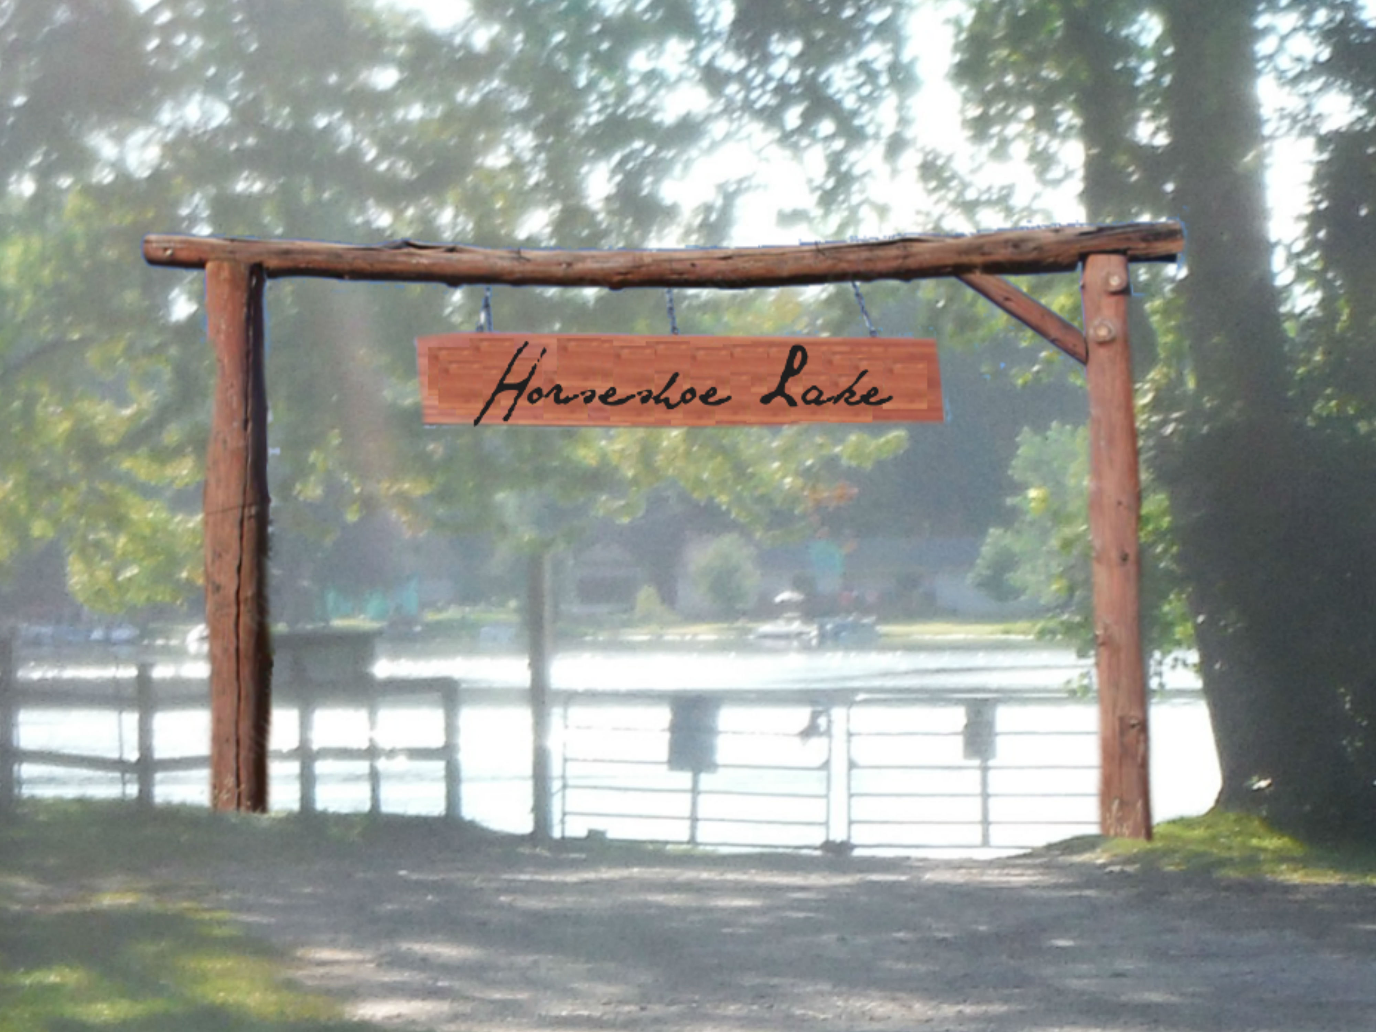
Boat Launch

Slide 4
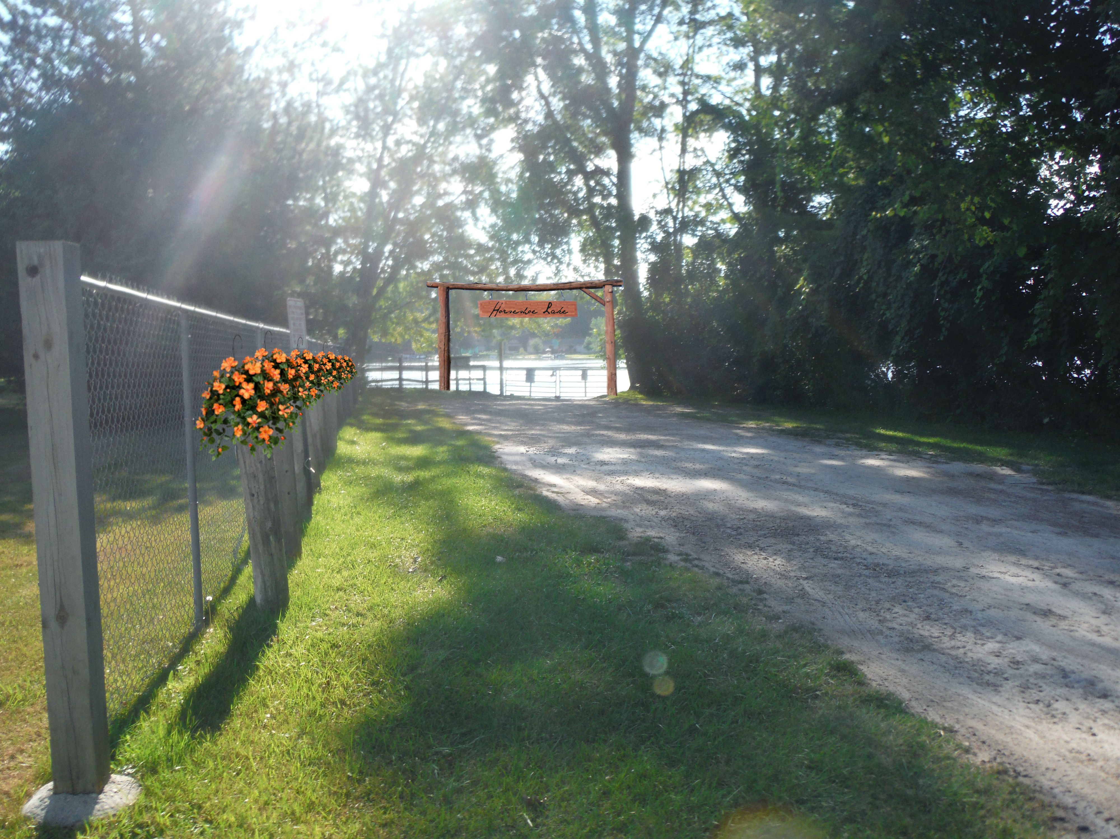
Boat Launch

Slide 5
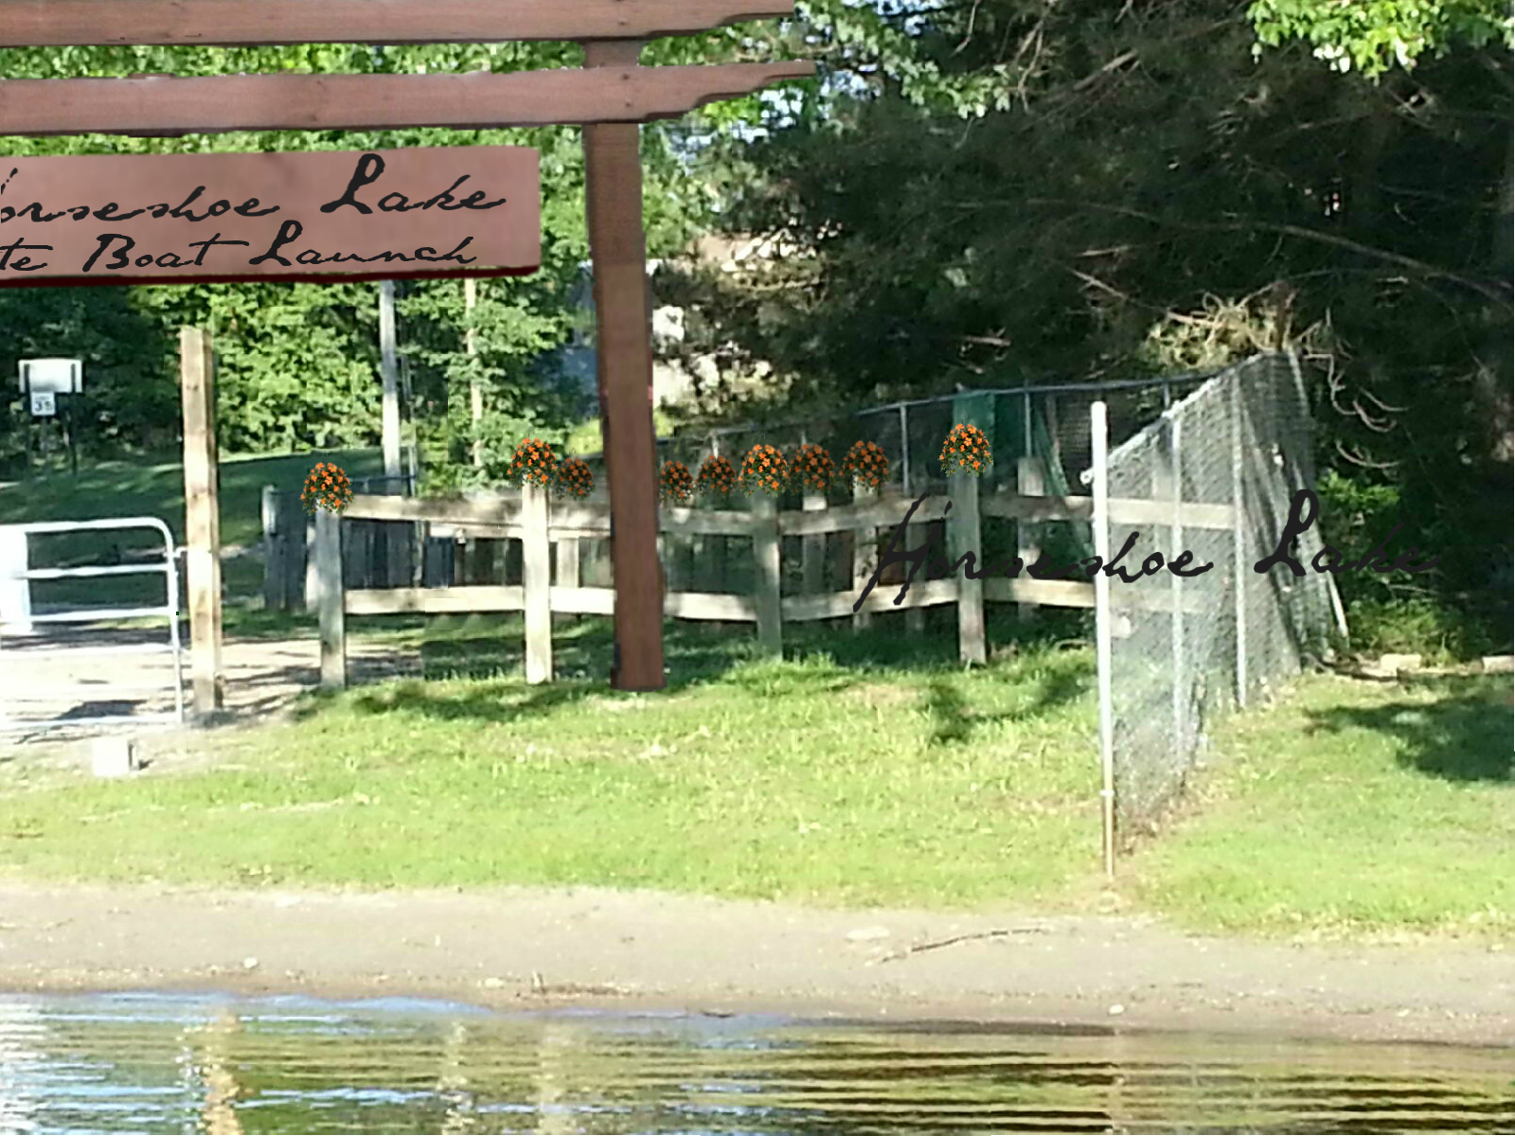
Boat Launch

Slide 6
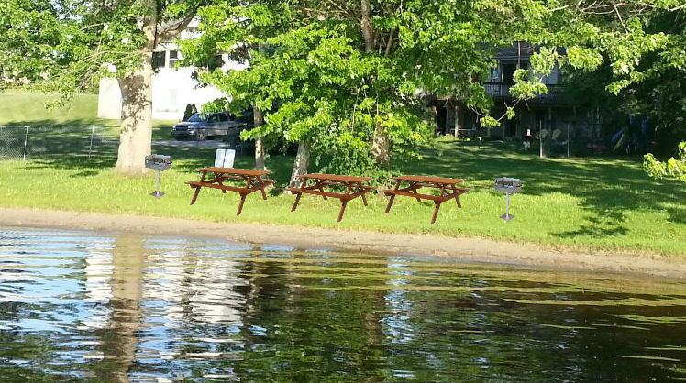
Leocadia Park

Slide 7
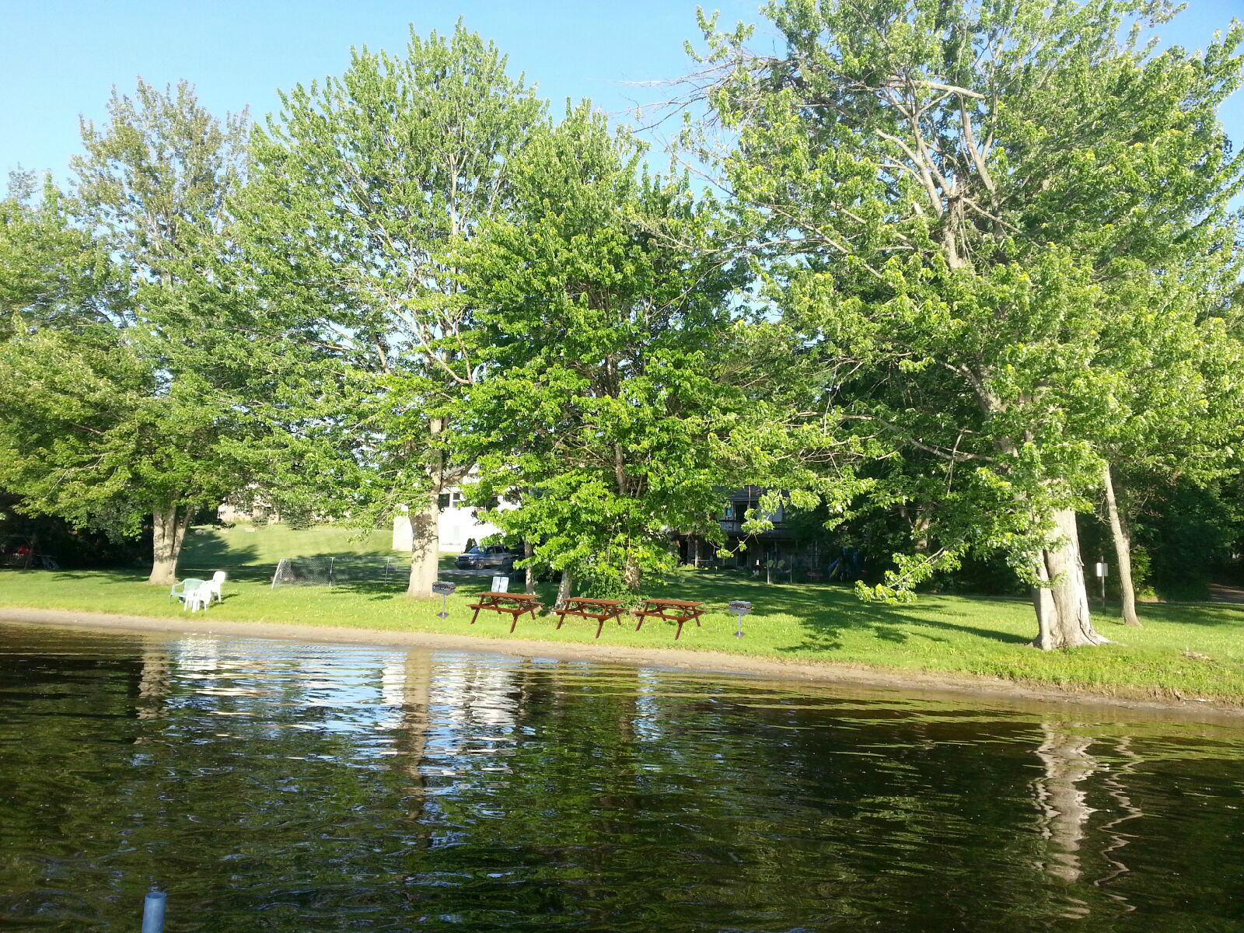
Leocadia Park

Slide 8
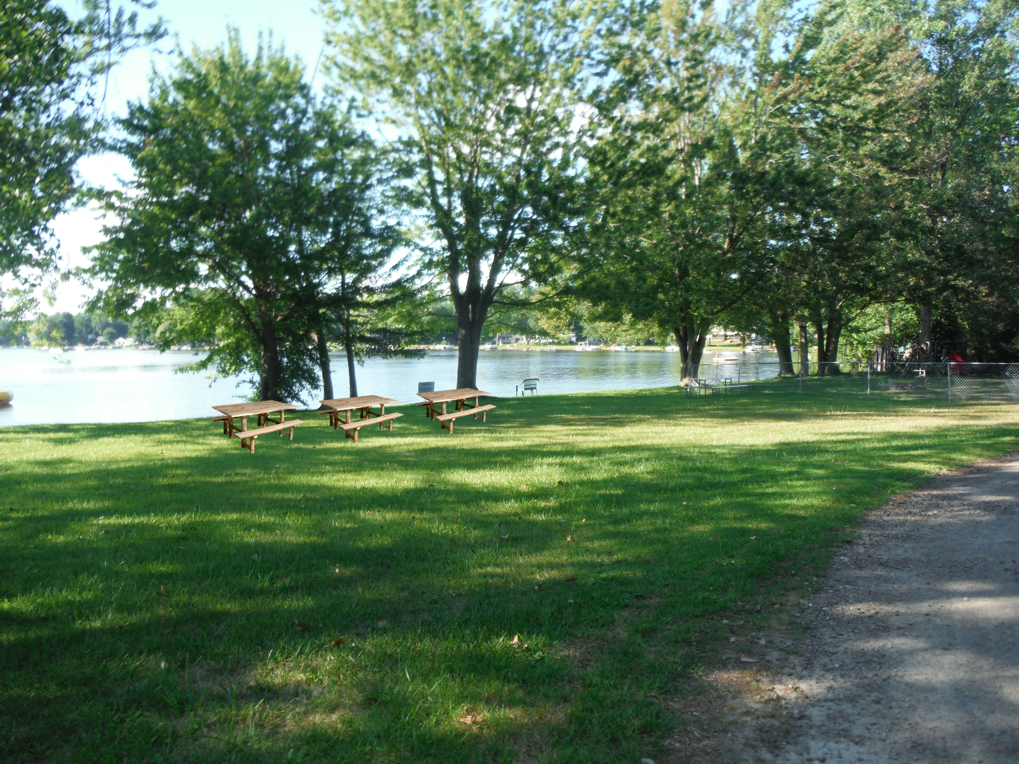
Leocadia Park

Slide 9
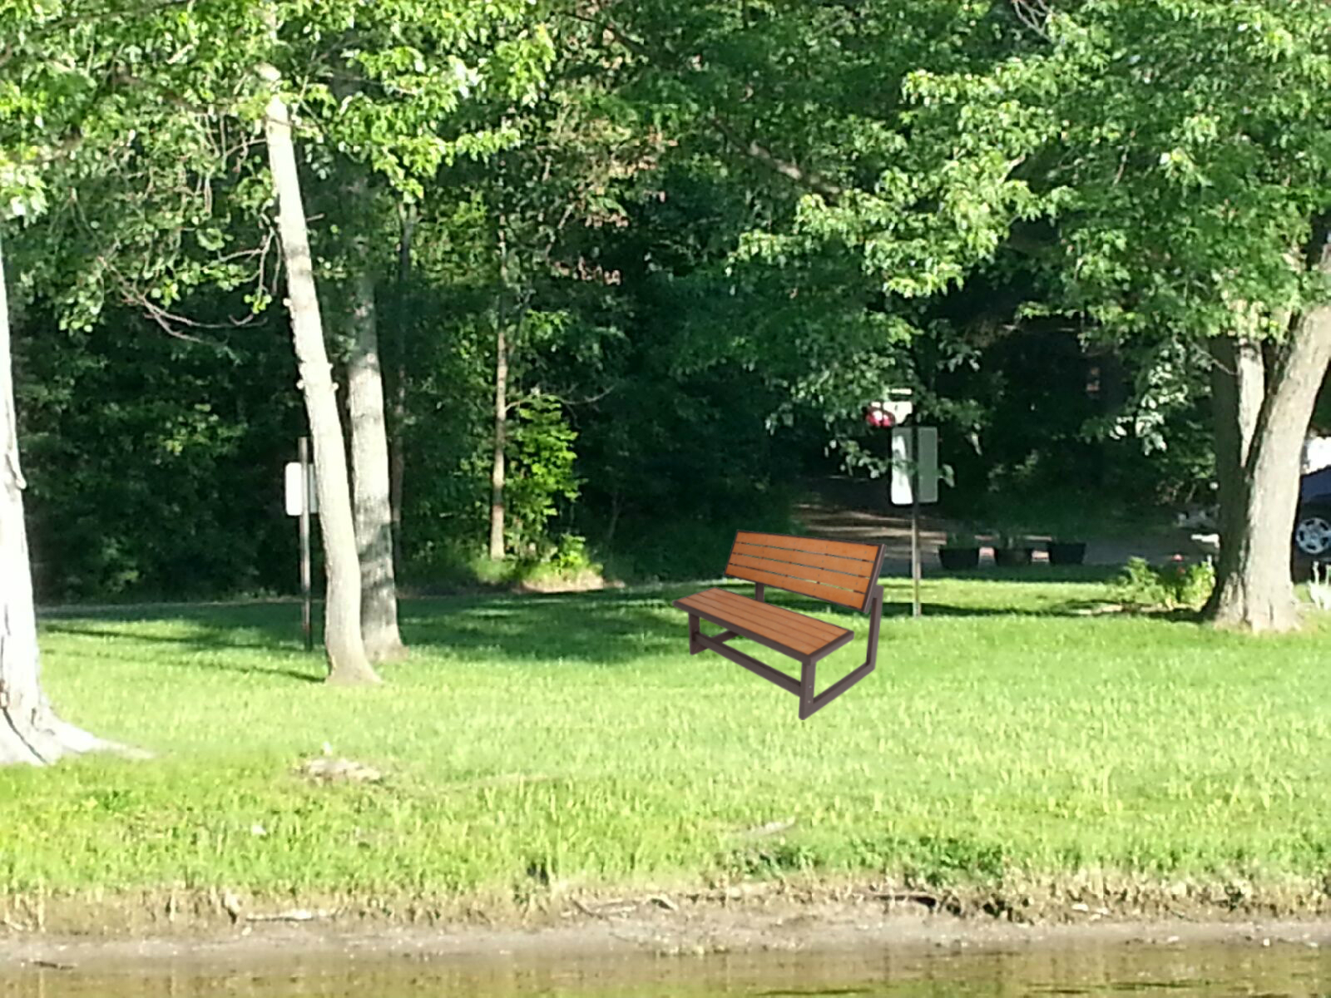
Leocadia Park

Slide 10
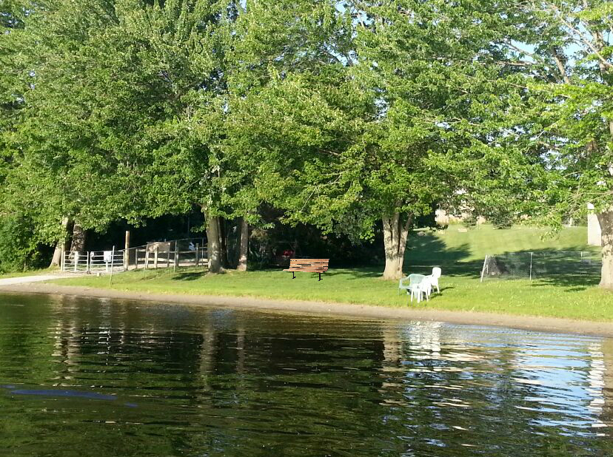
Leocadia Park

Slide 11
Lincoln

Slide 12
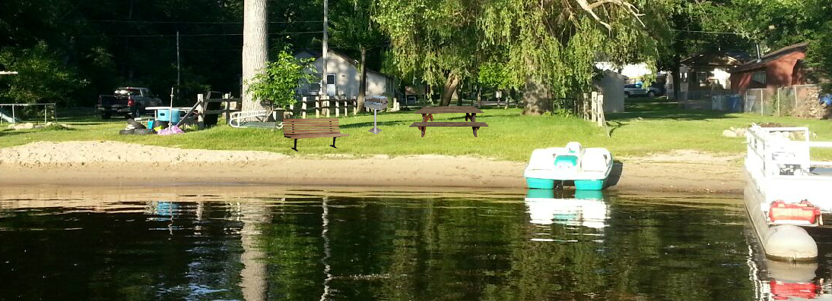
Lincoln

Slide 13
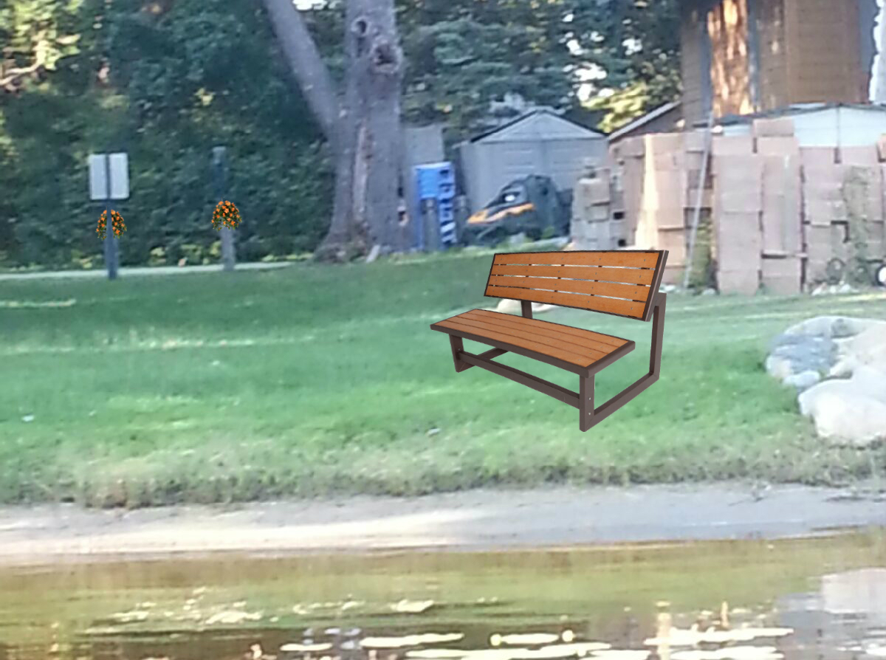
Lincoln

Slide 14
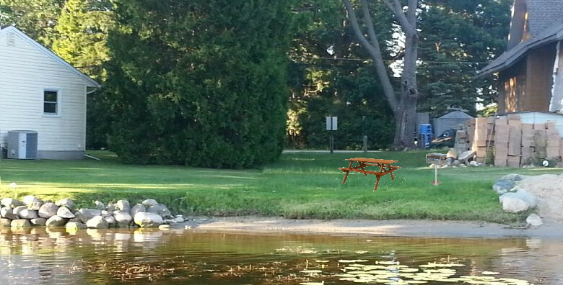
Lincoln

Slide 15
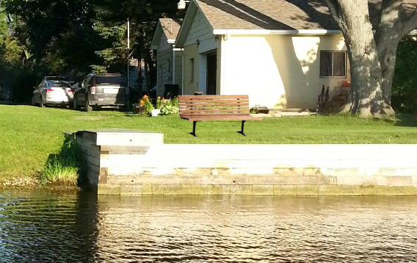
Lincoln

Slide 16
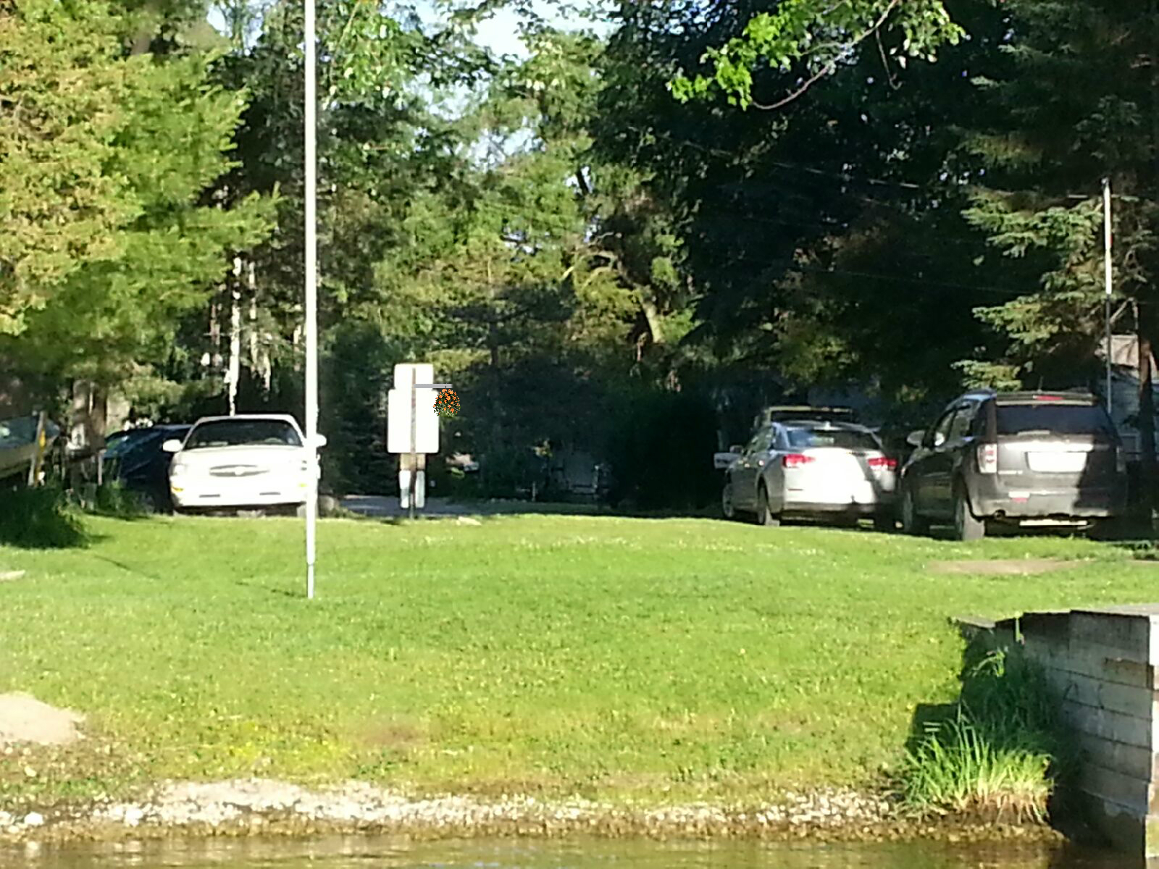
Lincoln

Slide 17
Schrum

Slide 18
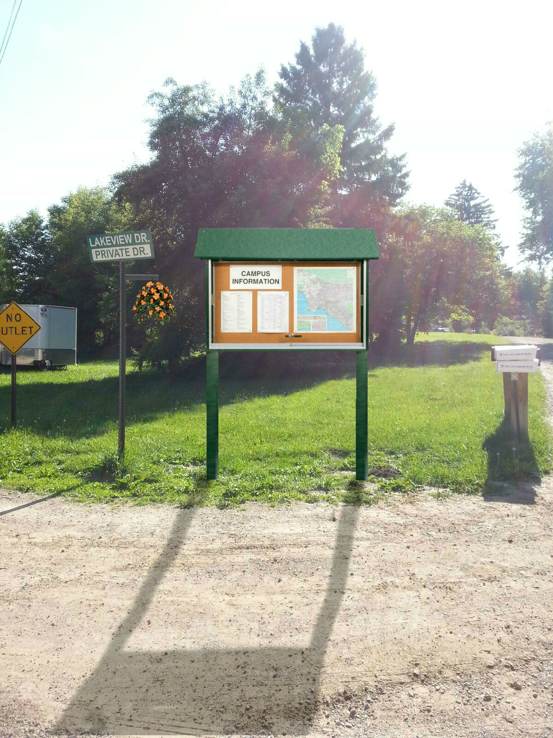
Schrum

Slide 19
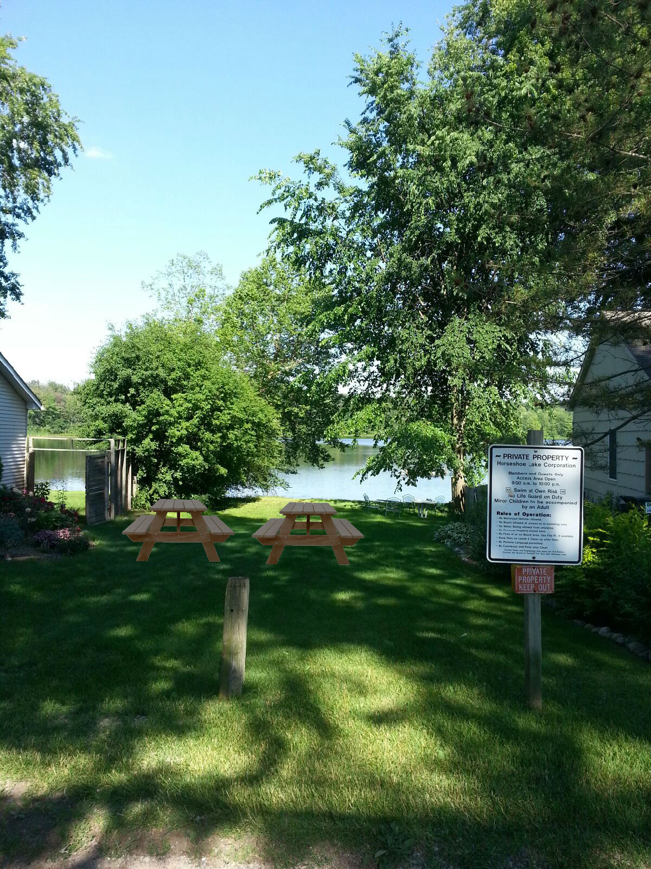
Schrum

Slide 20

Schrum

Slide 21

Schrum

Slide 22

Schrum

Slide 23
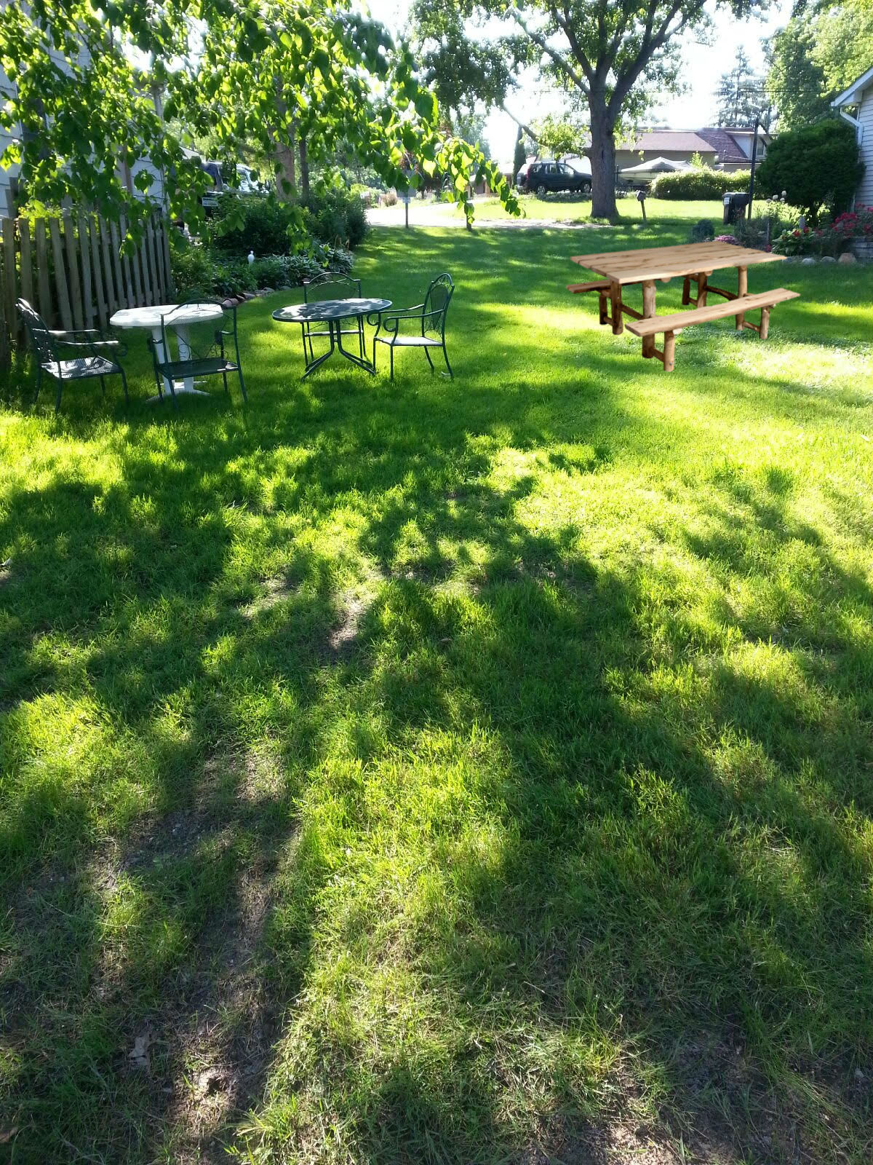
Schrum

Slide 24
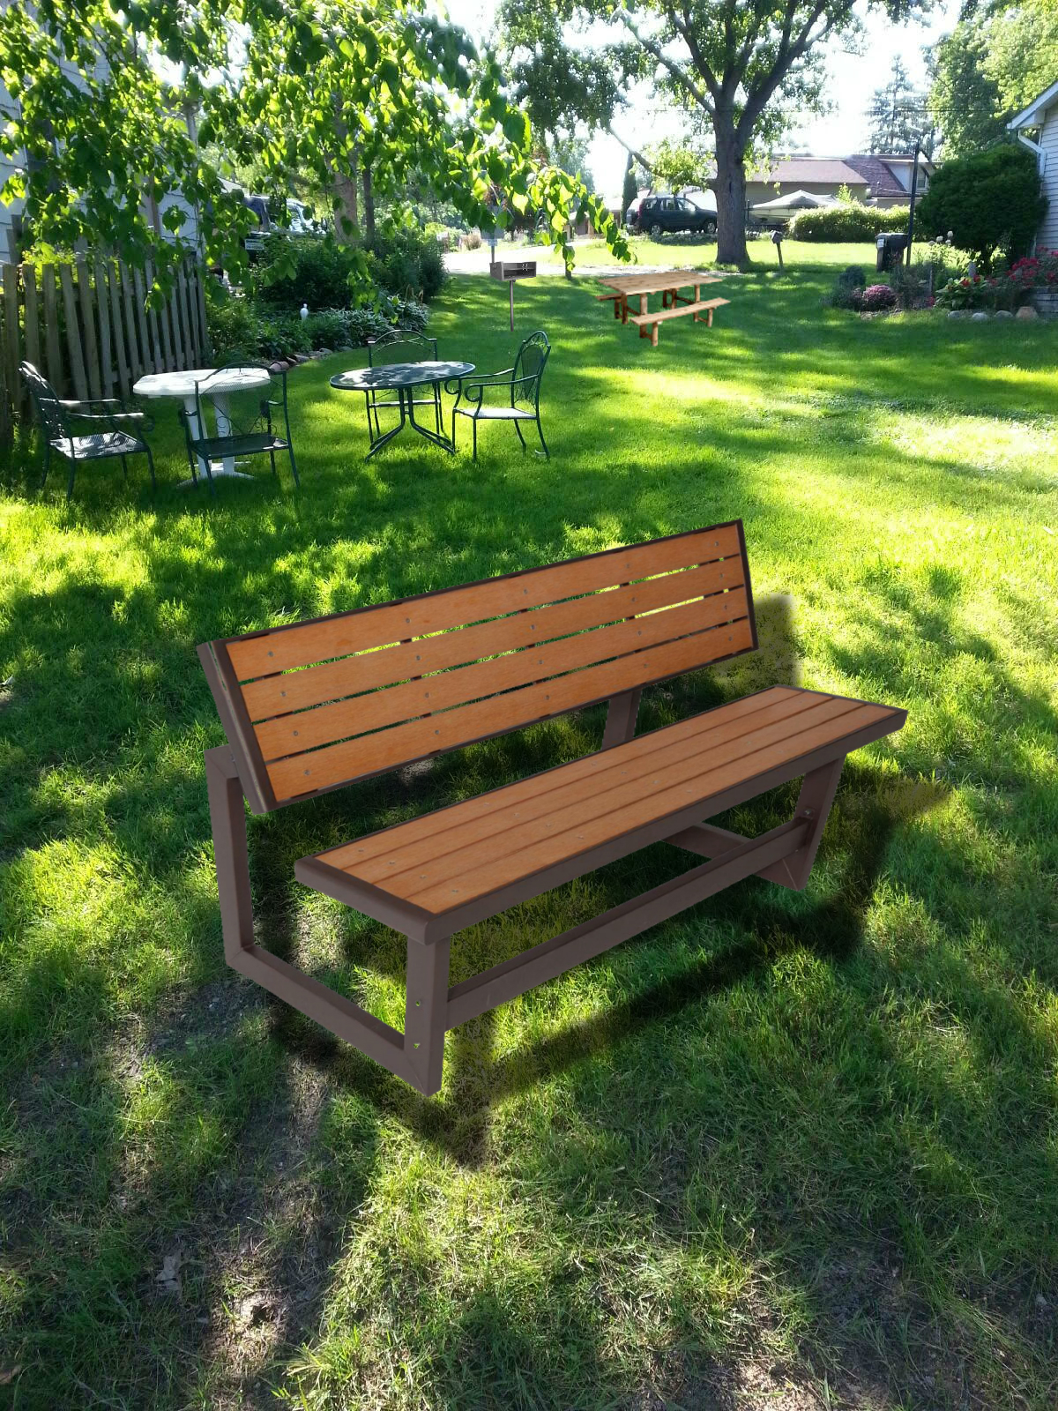
Schrum

Slide 25
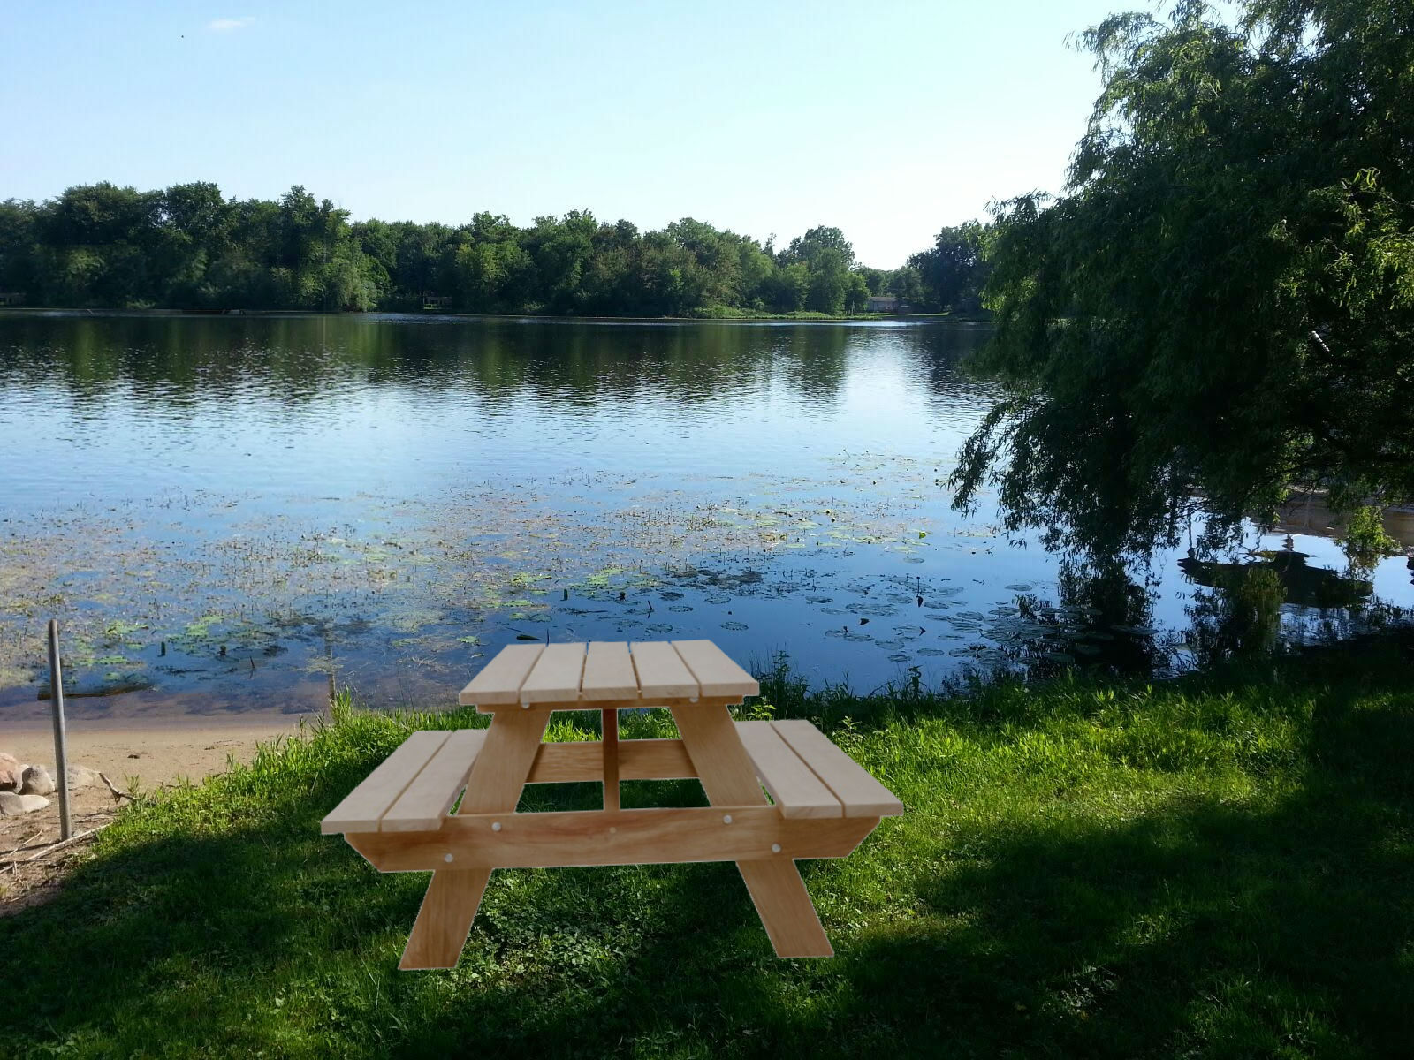
Schrum

Slide 26
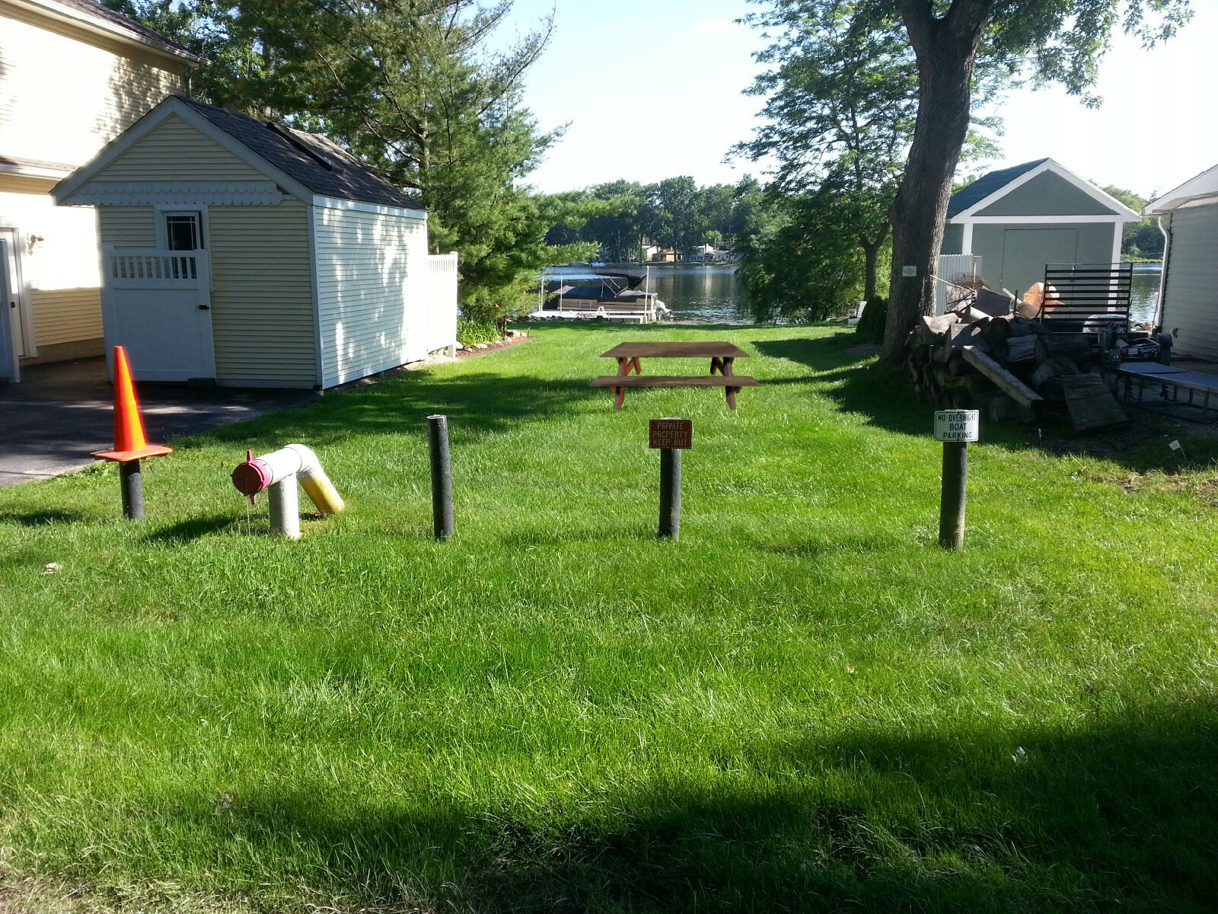
Schrum

Slide 27
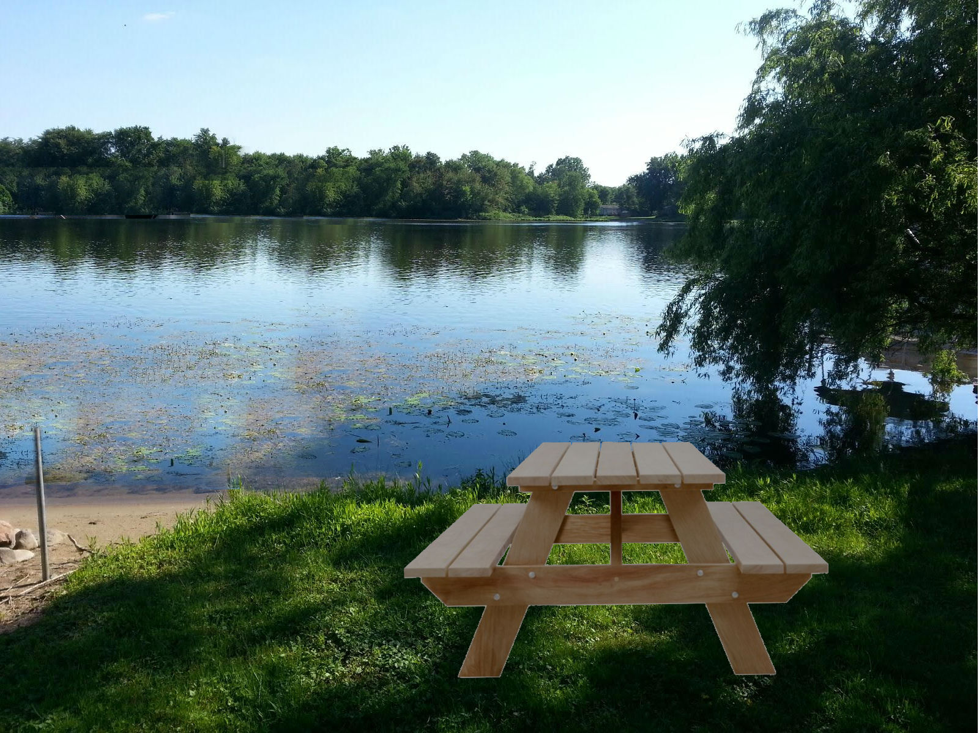
Schrum

Slide 28
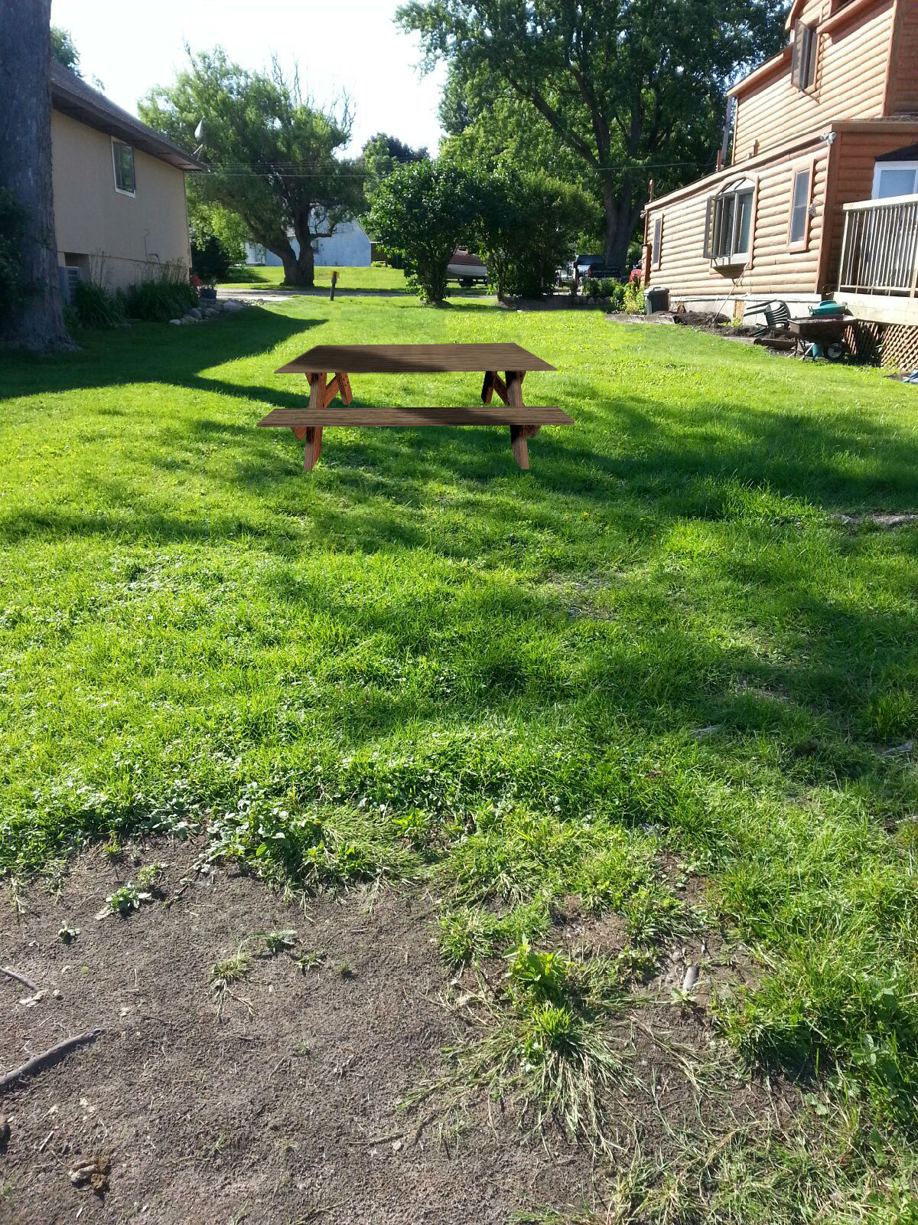
Schrum

Slide 29
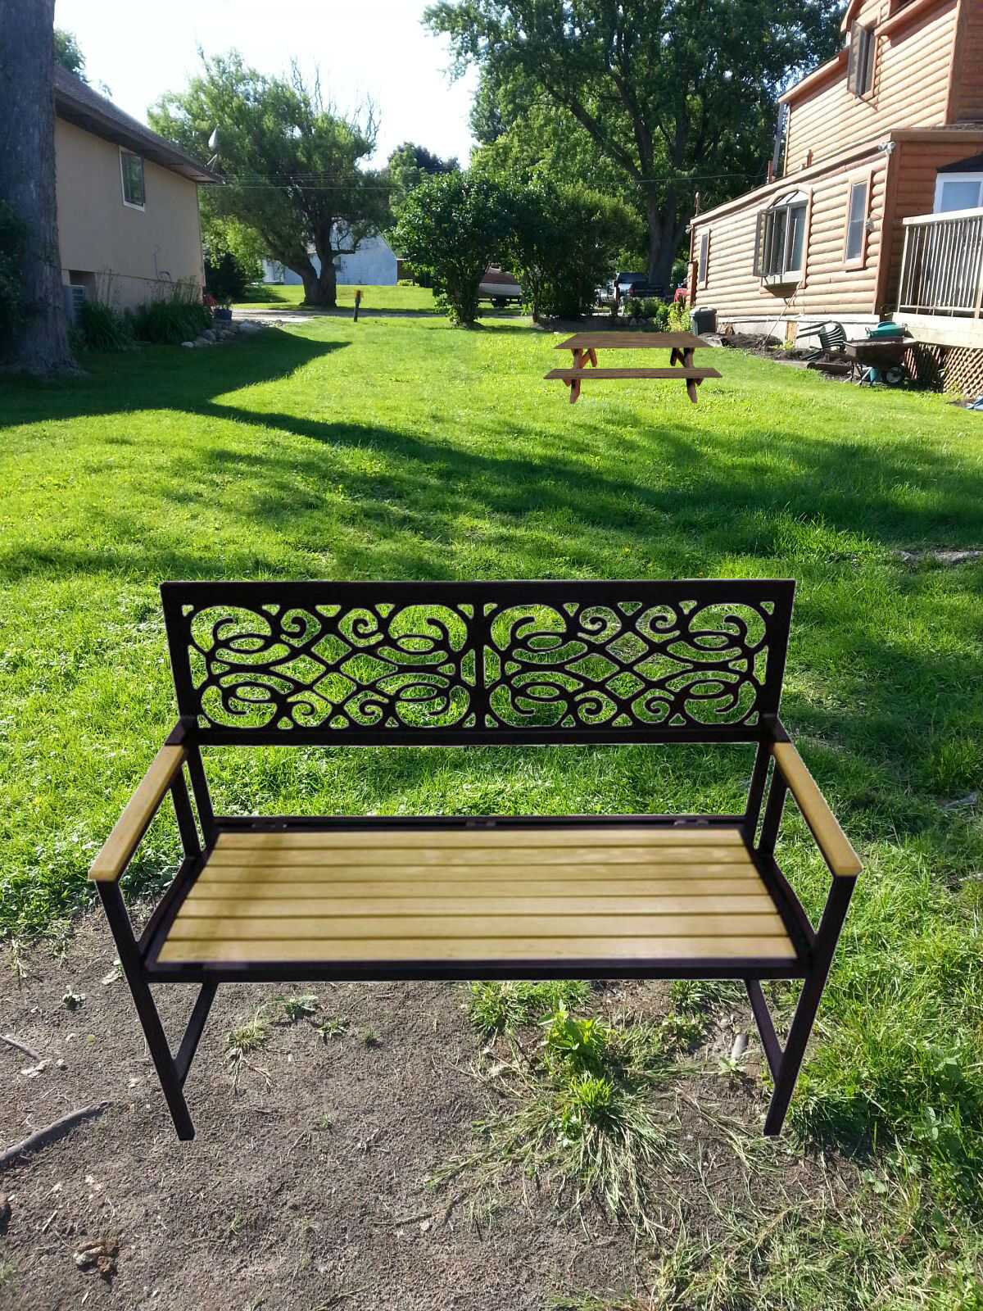
Schrum

Slide 30
Shady Beach

Slide 31
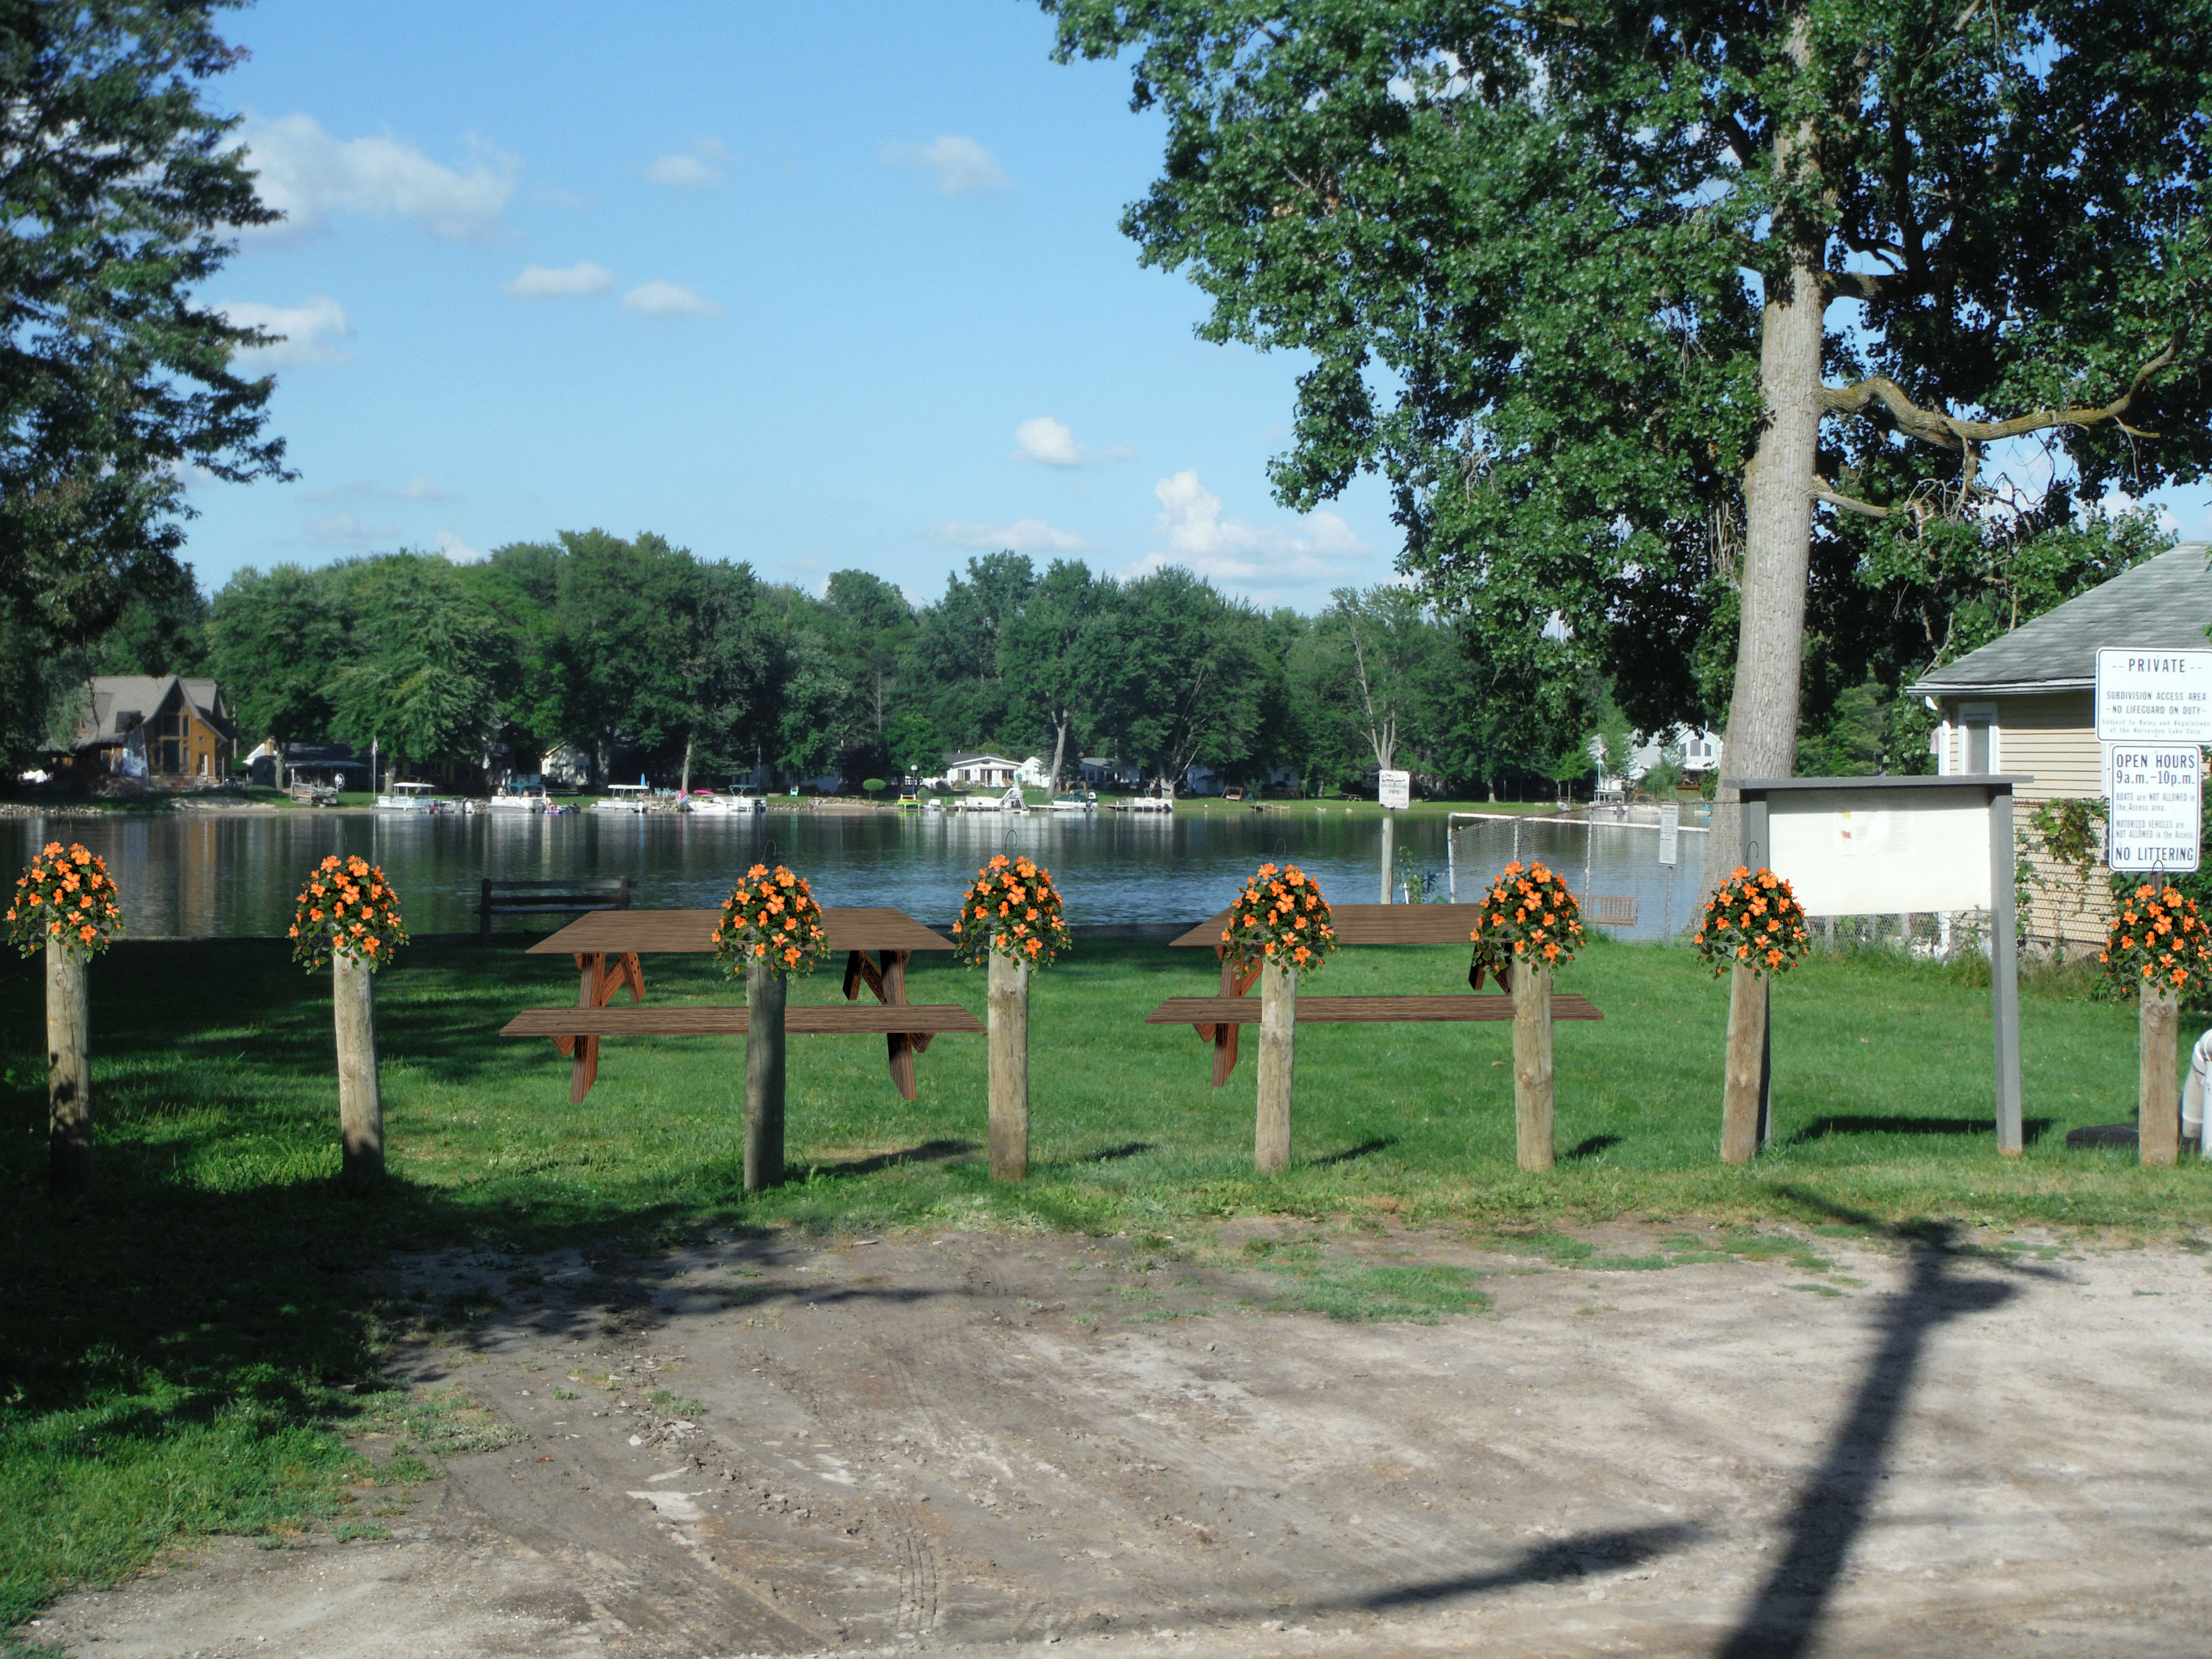
Shady Beach

Slide 32
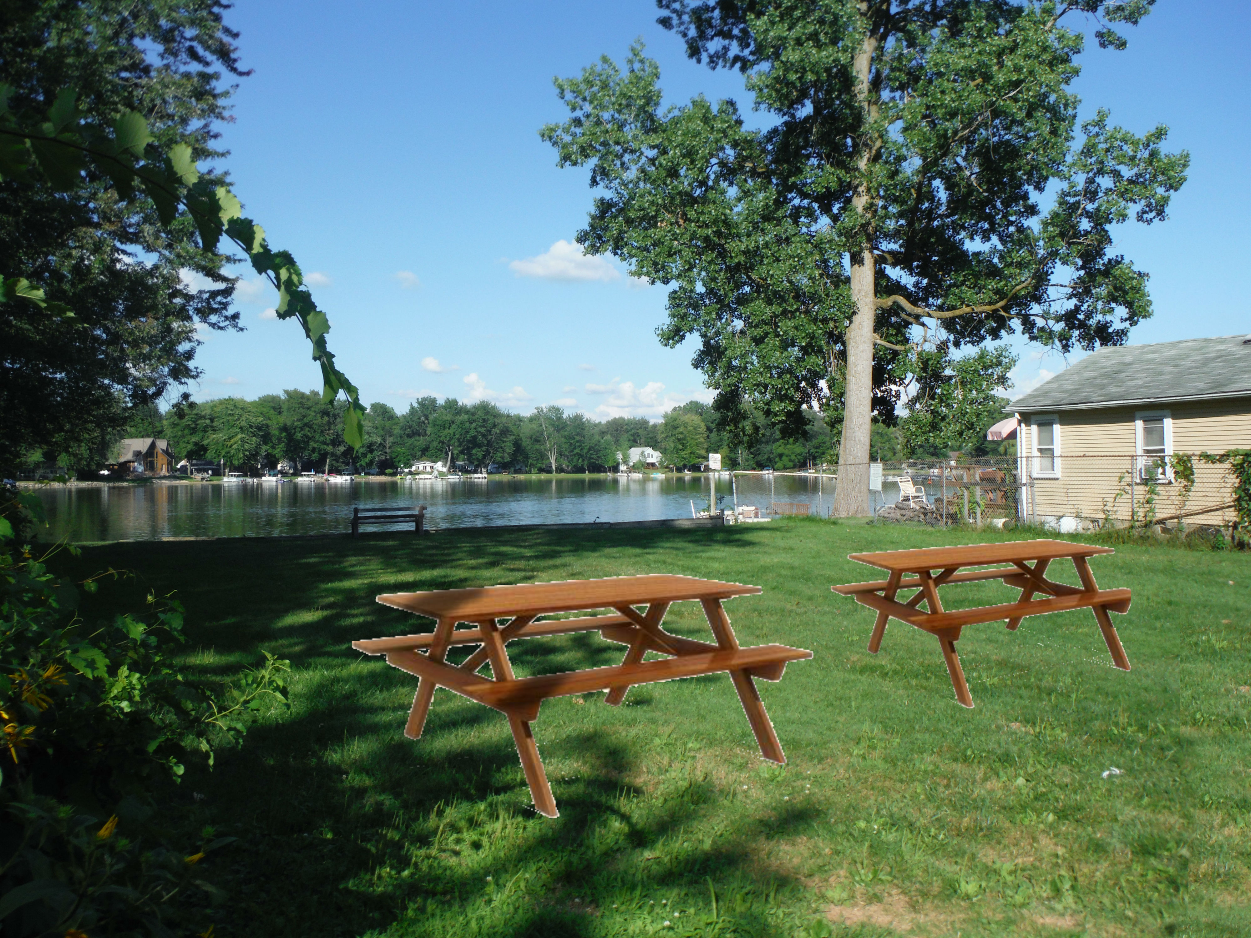
Shady Beach

Slide 33
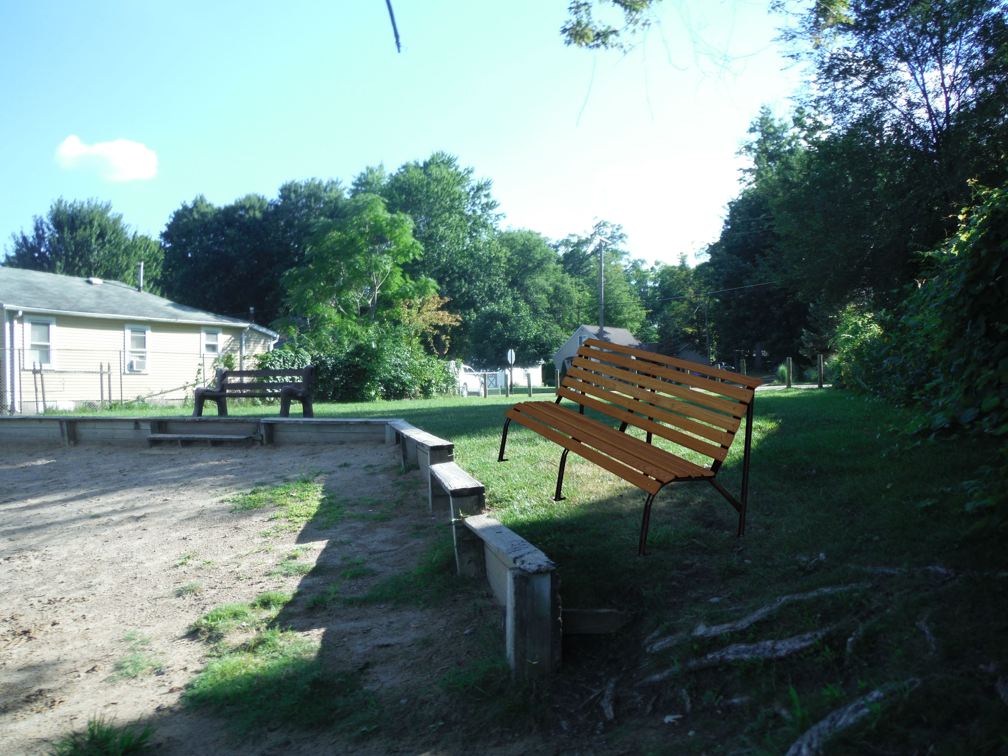
Shady Beach

Slide 34
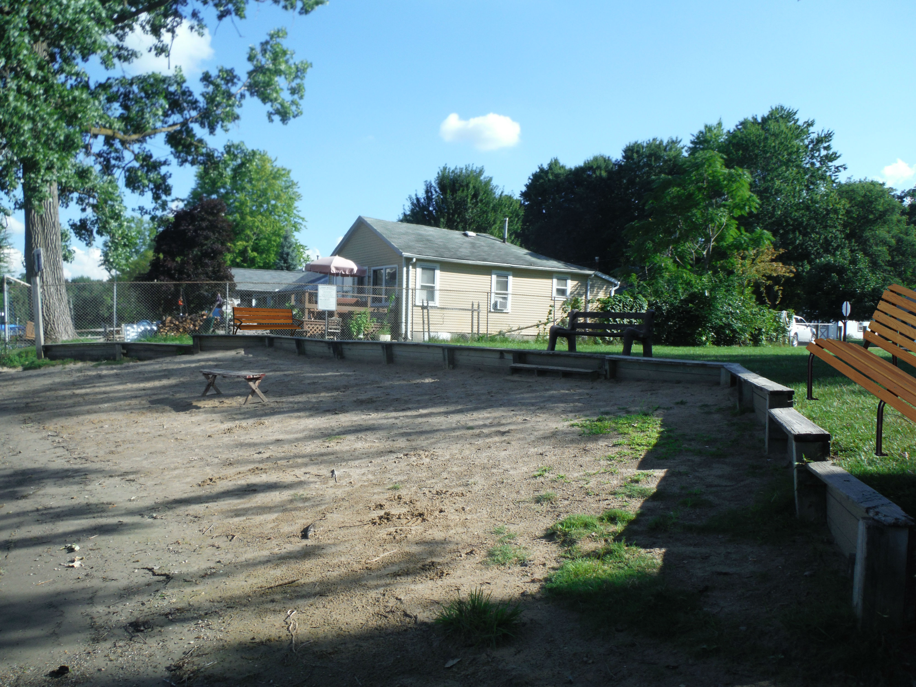
Shady Beach

Slide 35
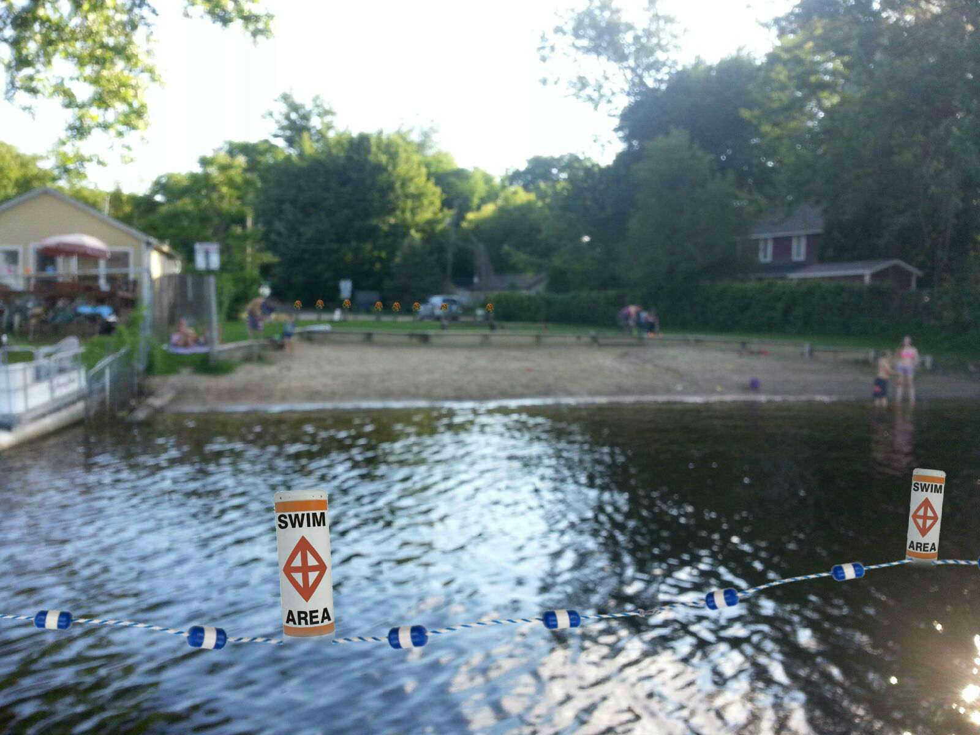
Shady Beach

Slide 36
Strolling Paths

Slide 37
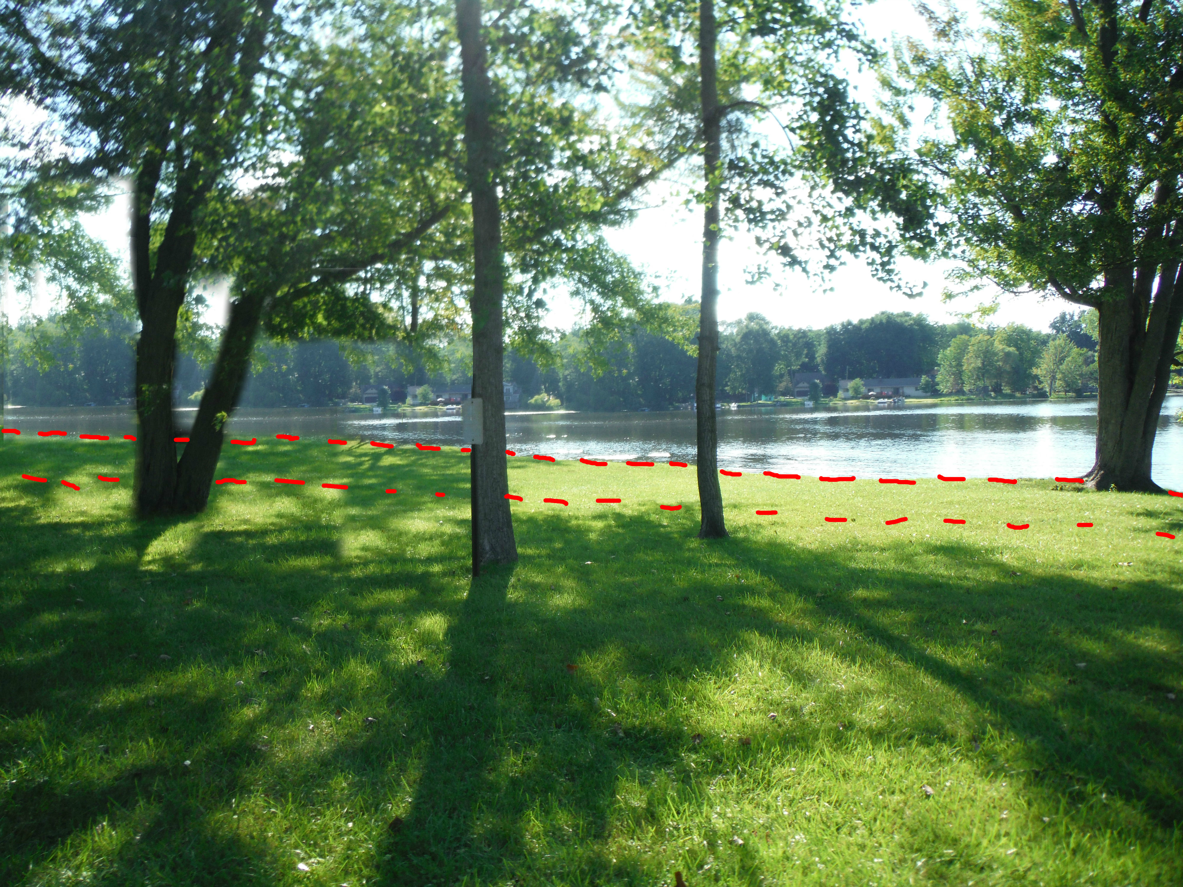
Strolling Paths

Slide 38
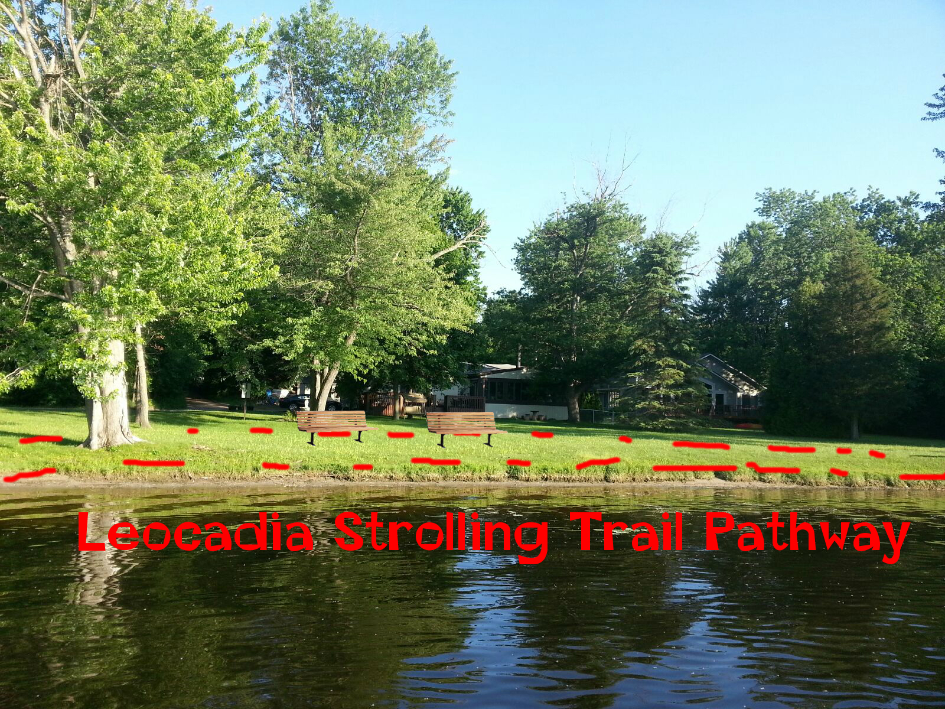
Strolling Paths

Slide 39
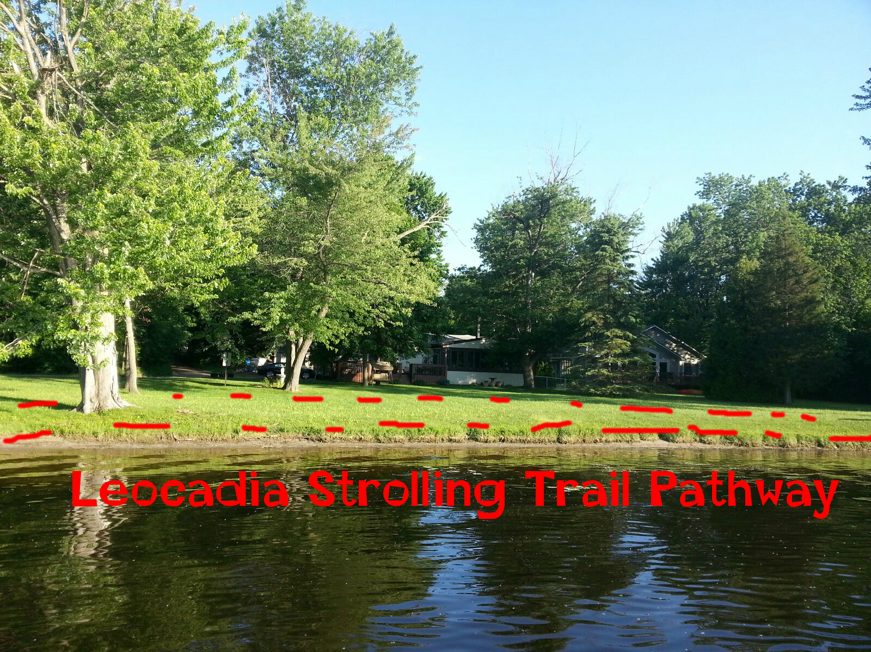
Strolling Paths

Slide 40
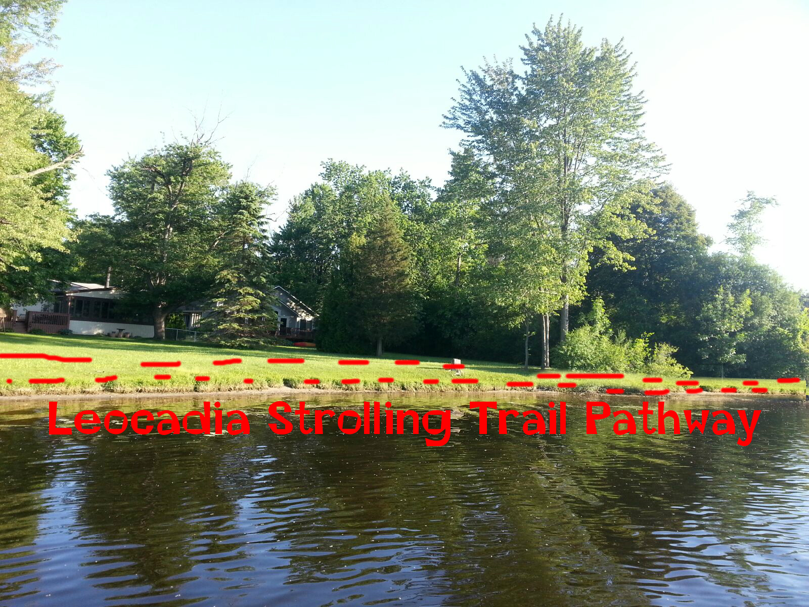
Strolling Paths

Slide 41
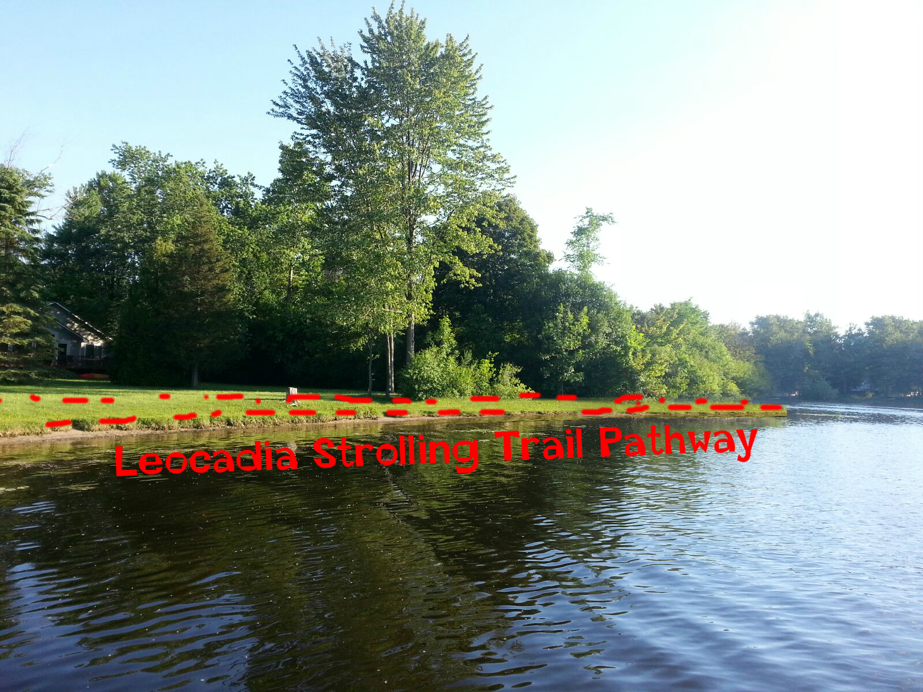
Strolling Paths

Slide 42
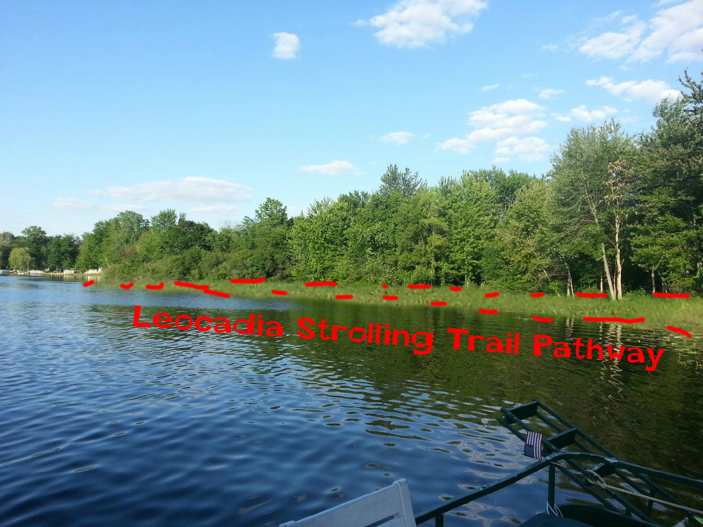
Strolling Paths

Slide 43
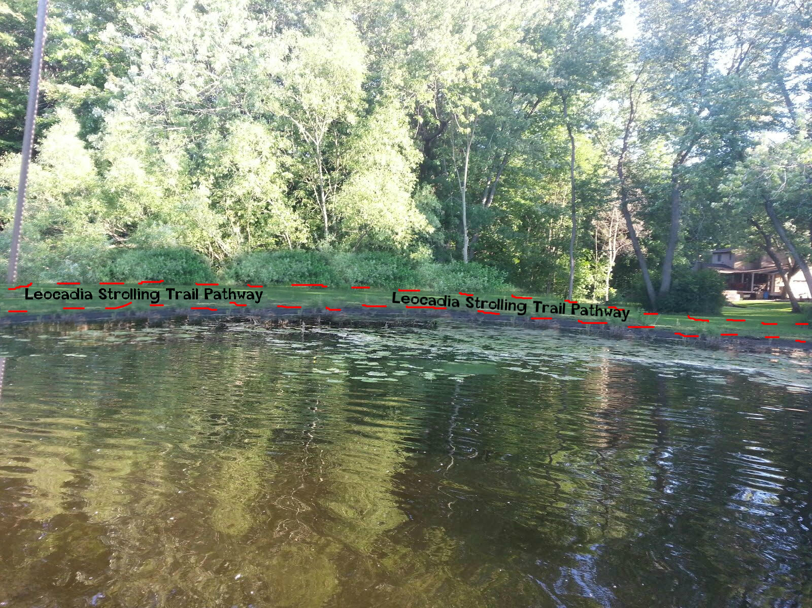
Strolling Paths

Slide 44
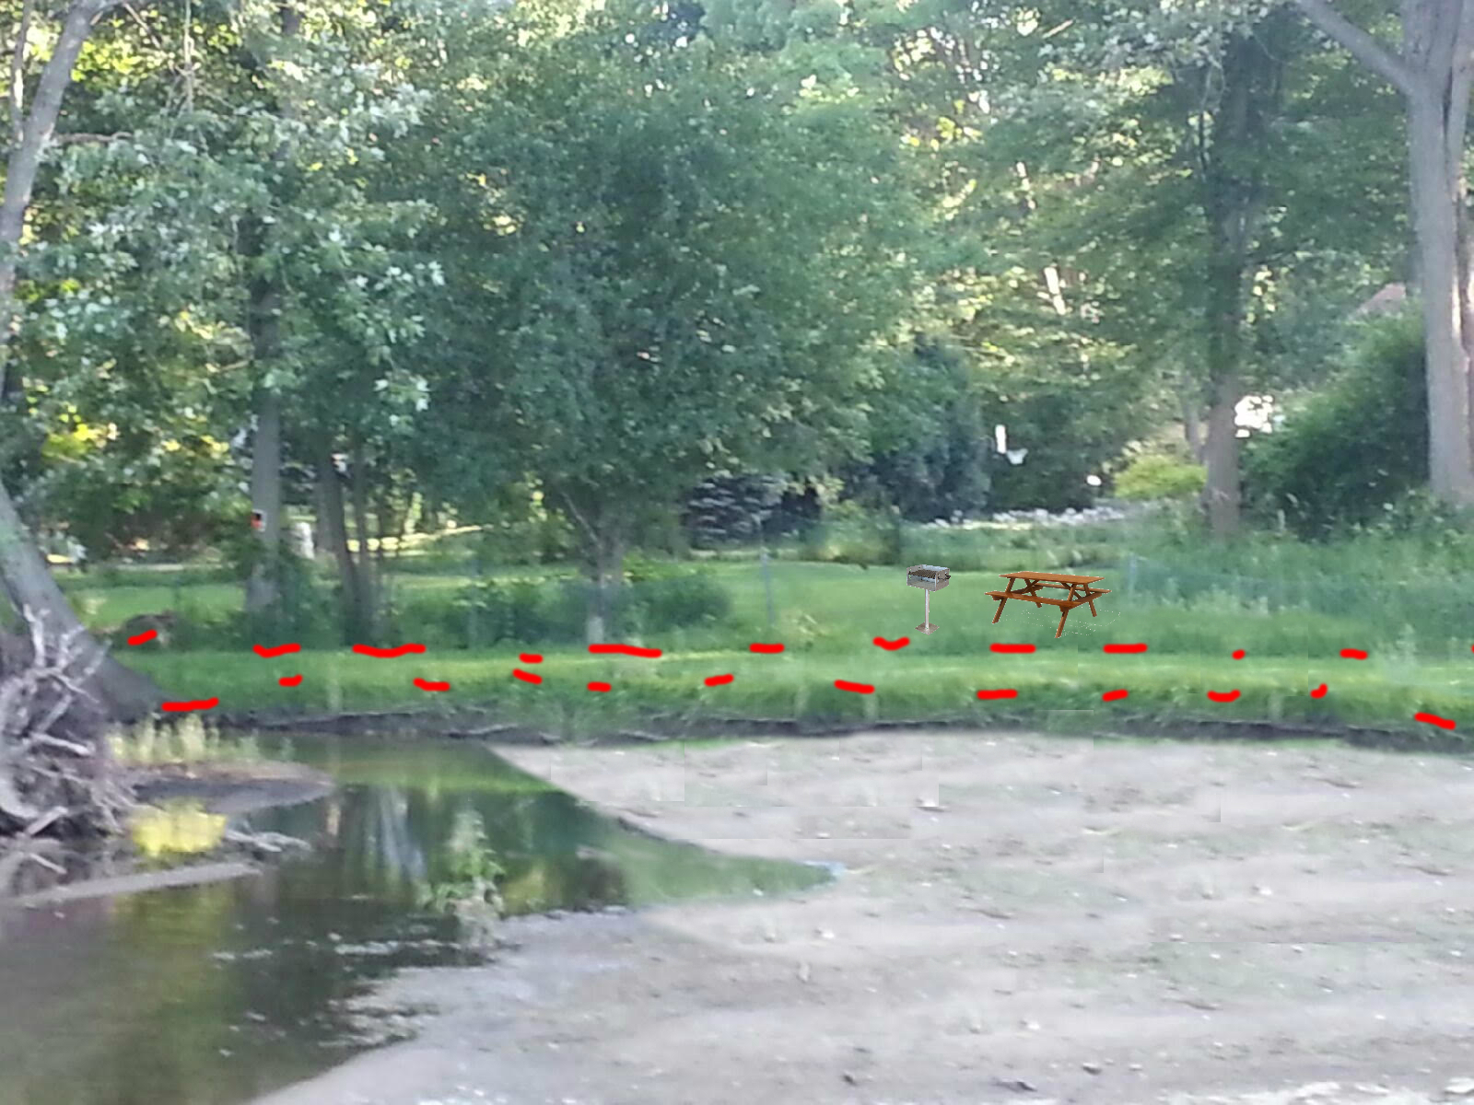
Strolling Paths

Slide 45
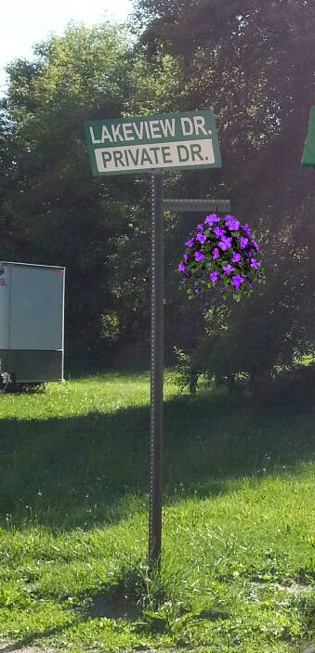
Areas for projected plans
Accesses
Street appearance
Boat launch

Slide 46
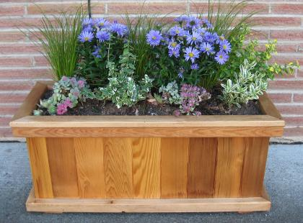
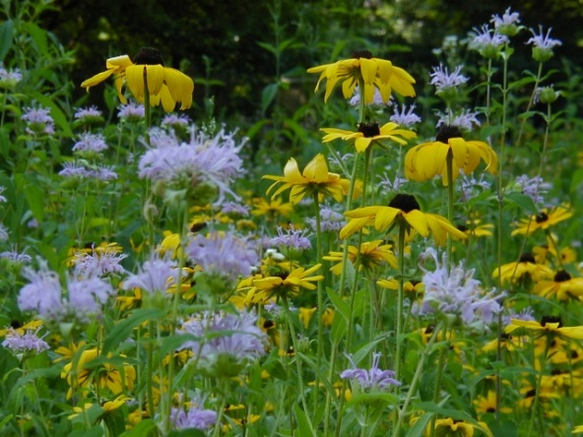
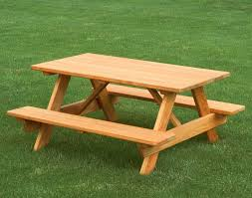
Let’s do this together!
Volunteers wanted!
  Saves labor
  Meet your neighbors
  Sense of community

Slide 47





Shady Beach

Slide 48

Leocadia Park

Slide 49
Boat launch

Slide 50
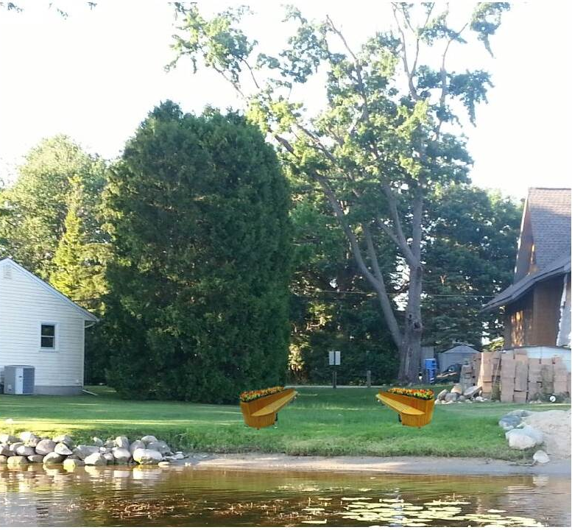
Lincoln

Slide 51
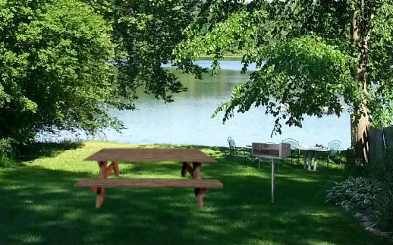


Schrum

Slide 52
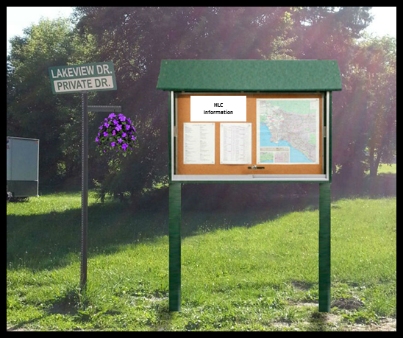
Concerns
Vandalism
  Community participation will lead to community pride!
  Keep vigilant!
Maintenance and upkeep
  “Street captains”
  Sub volunteers
Costs
  Lowered with community labor
“But I don’t use the…….”
  Will improve the “curb appeal”, overall neighborhood appearance
  Community pride
  Resale value

